Slide 1


Slide 2


Slide 3
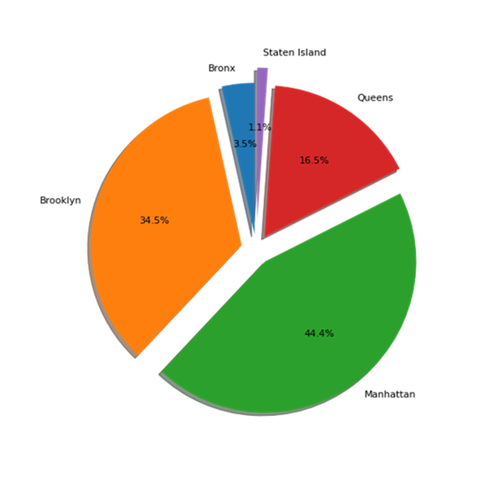
Distribution of Properties by Borough (total of 48,895 properties)

Slide 4
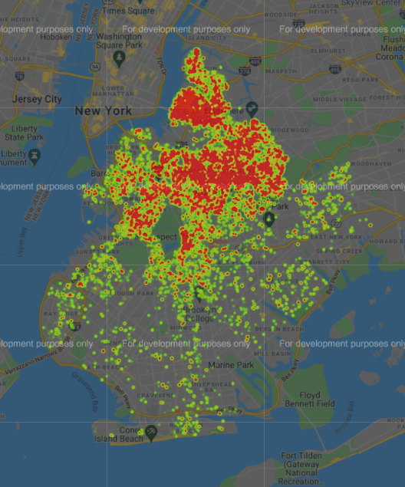
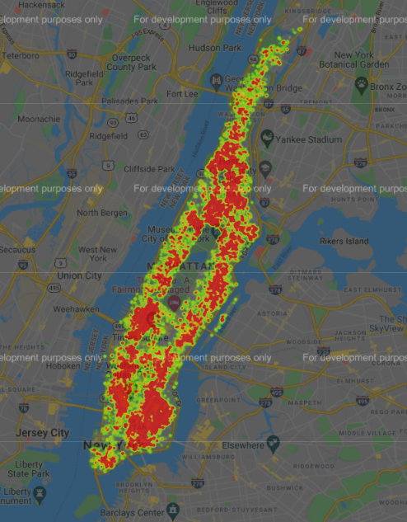
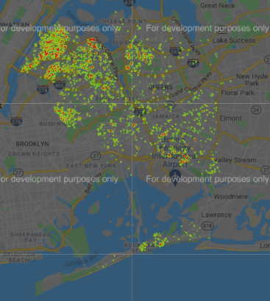
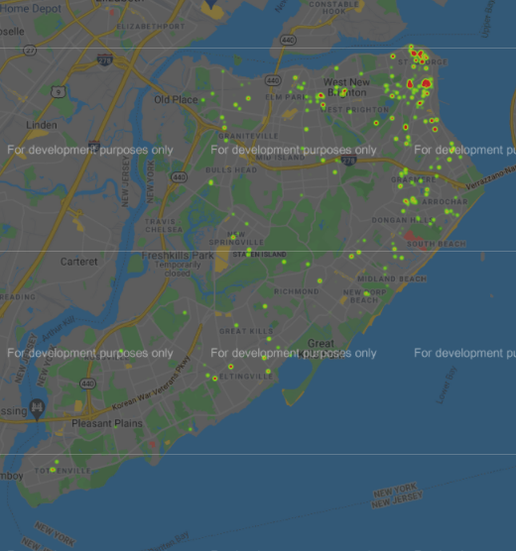
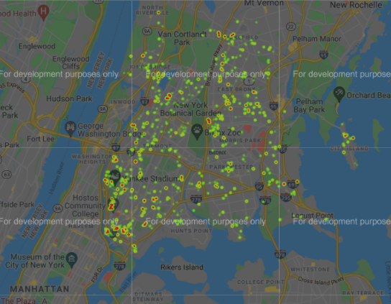
Number of Reviews by Borough
Brooklyn
Manhattan
Queens
the Bronx
Staten Island

Slide 5
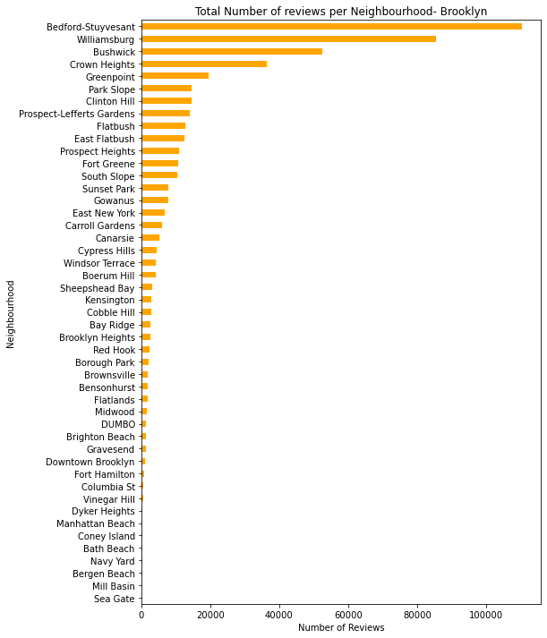
Brooklyn
Top number of reviews
486,574 total reviews
24.20 mean number of reviews

Slide 6
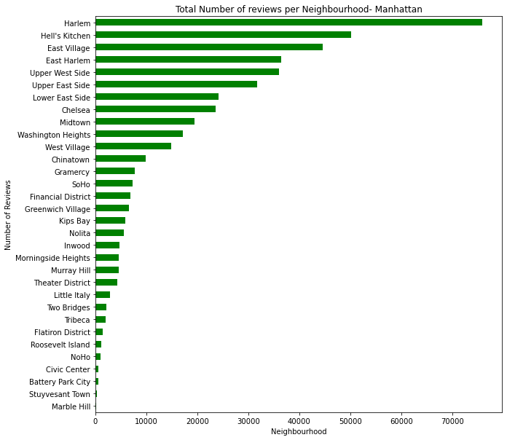
Manhattan
Second highest number of reviews
454,569 total reviews
20.99 mean number of reviews

Slide 7
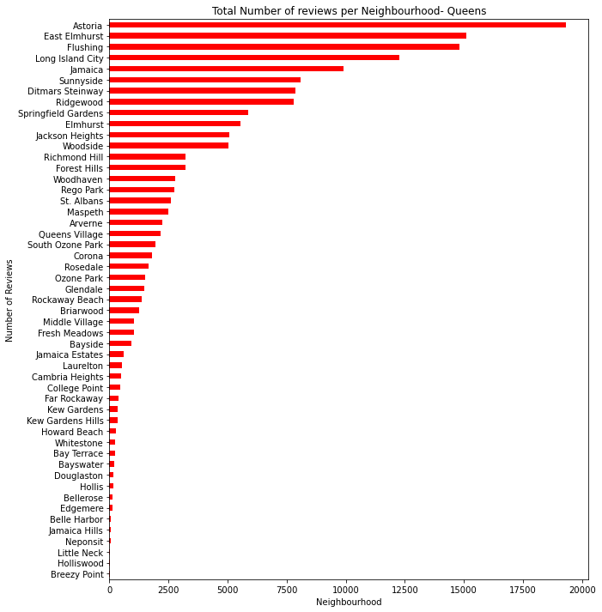
Queens
156,950 total reviews
27.70 mean number of reviews

Slide 8
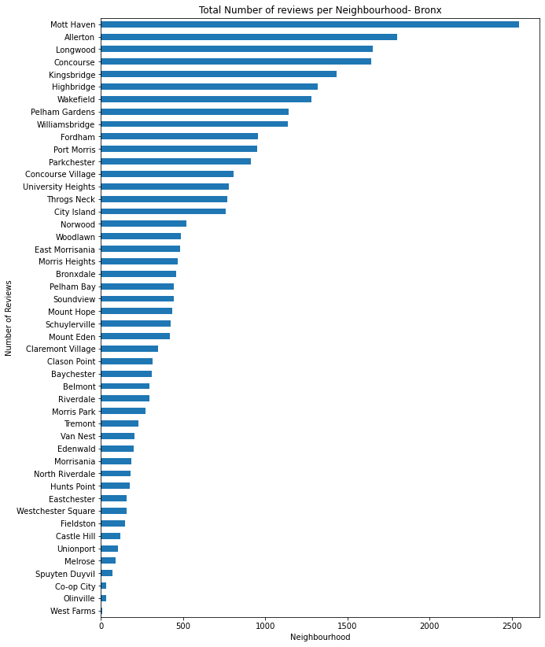
Bronx
28,371 total reviews
26.00 mean number of reviews

Slide 9
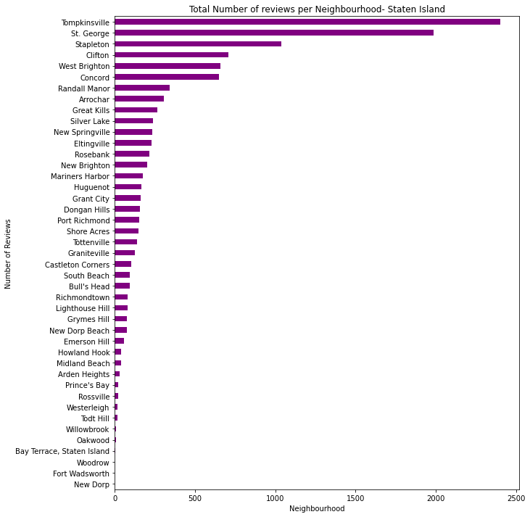
Staten Island
Least number of reviews on properties.
11,541 total reviews
30.94 mean number of reviews

Slide 10
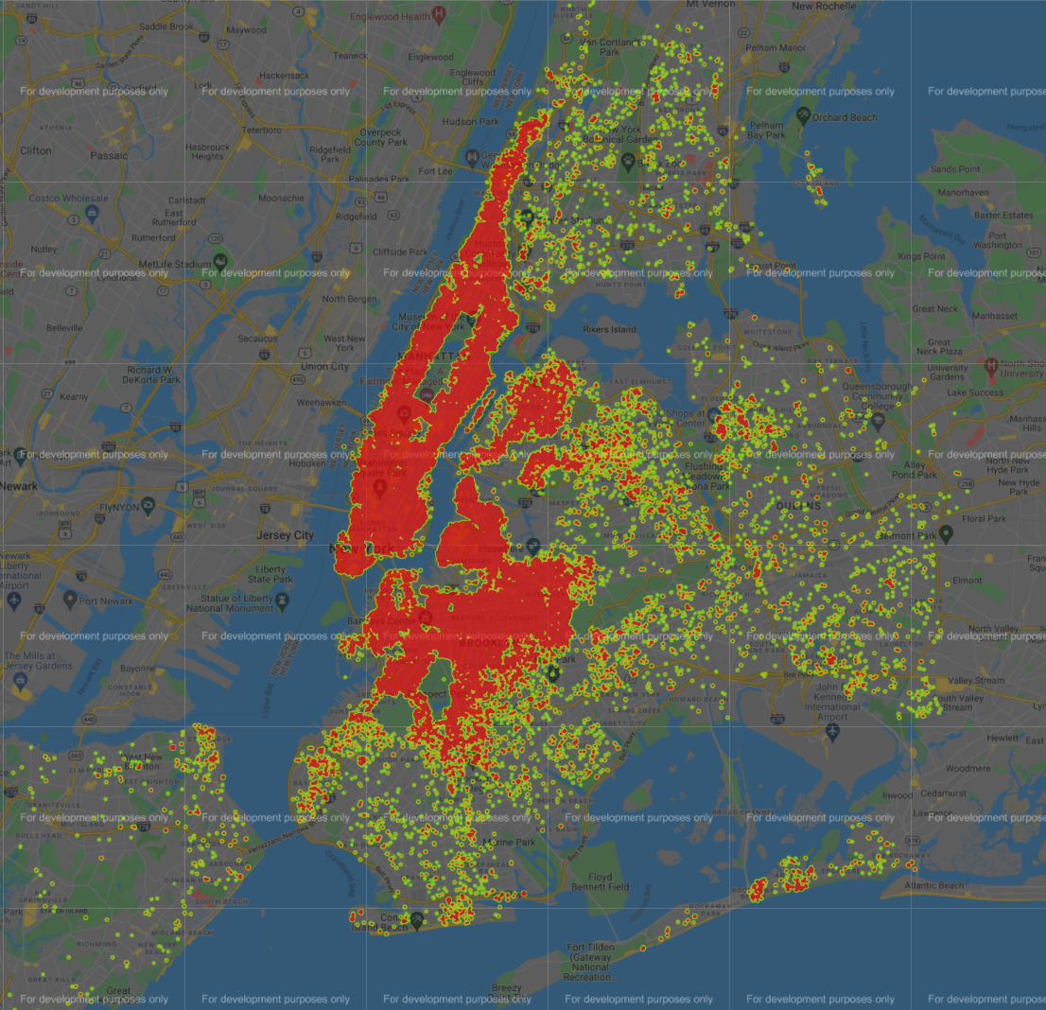
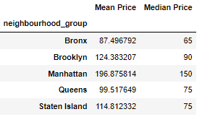
Prices by Borough
Text here

Slide 11
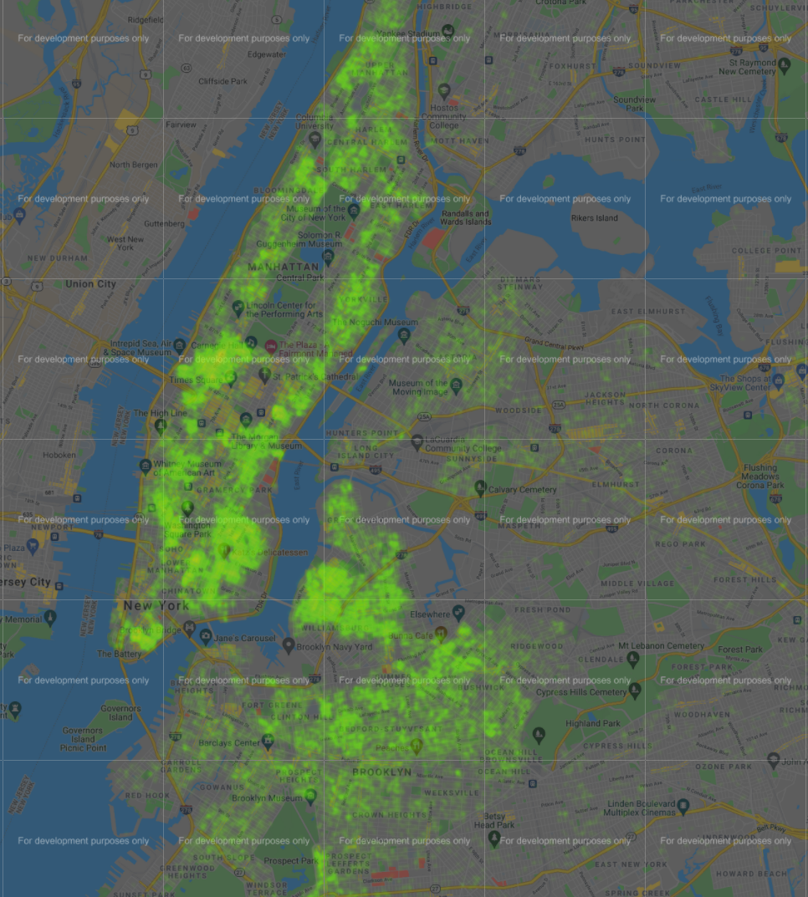
Subway Stations

Slide 12
Two sample T-test: the mean income of Manhattan and Brooklyn

